Slide 1
INTRODUCTION TO POWER BI- DATA TRANSFORMATION (DATA EDITING & MODIFICATIONS)

Slide 2
POWER DATA EDITING
Power BI Data Editing is used to add new capabilities to the data.
Using Power BI Data Editing, we can remove rows, columns , modify/ replace values, filter data and add new calculated columns to the existing data. Also its support features of merge and append data from multiple sources.
To Edit data in Power BI click on Edit Queries

Slide 3
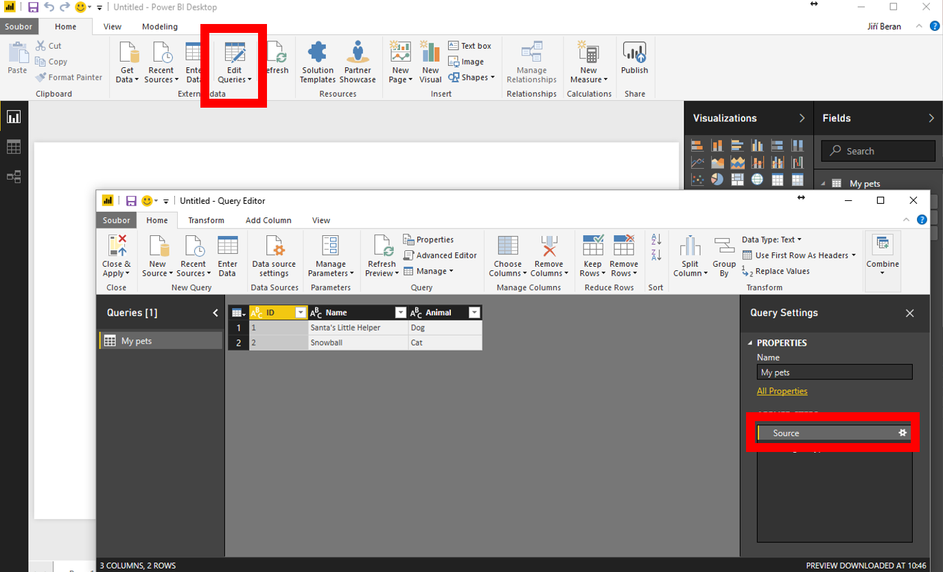

Slide 4
POWER BI DATA EDITING FEATURES
FEATURES | DESCRIPTION
REMOVE ROWS | This will remove the rows from table, which is used to clean or remove the error records from the table.
REMOVE COLUMNS | This will remove columns from the table. Single column or multiple columns can be removed using this feature.
SPLIT COLUMN | This will split a column into multiple columns based upon a splitter. Eg : Name can be splitted into FirstName and LastName
MERGE COLUMN | This will merge two column into single column. Eg : FirstName and LastName can be combined into FullName
REPLACE VALUES | This will replace values in the column of the tables. All values in a particular column will be replaced by new values. Eg : Male can be replaced by M
USE FIRST ROW AS HEADER | This will make the data row as the header of the table/datasets. The values of the column will be come the column-names of the table.
FILTER DATA | This will filter the columns values based upon which the rows of the table will be filtered. We can apply static filters in Power BI and dynamic filters can be done using Parameters.

Slide 5
POWER BI DATA EDITING FEATURES
FEATURES | DESCRIPTION
ADD CALCULATED COLUMN | This will add a new calculated column to the datasets of Power BI based upon an expression which can be used in visualization.
ADD INDEX COLULM | This will add a index column with a start value and increment value. It is like adding a sequence number to the table.
ADD CONDITION COLUMN | This is used to add a conditional column. The values will be based upon a condition. We can apply multiple conditions and based upon which the values will be populated.
TRANSFORM DATATYPE | This is used to change the data type from one data type to another data type.
DATE FUNCTIONS | This will apply date functions to the date time columns . For eg : Year, Month, Day etc
ARITHMATIC FUNCTIONS | This will apply arithmetic functions to the numerical values of the table.
ROUNDING FUNCTIONS | This will apply rounding functions to decimal number to round the numbers with precisions. For eg : 55.67889

Slide 6
POWER BI ADVANCE EDITING FEATURES
FEATURES | DESCRIPTION
MERGE DATA | We can combine data from multiple tables using Merge Command from different data sources. It will basically combine the columns from multiple tables. It is similar to joins. There should be a common column to do the merging. Different types of Merge / Joins are as follow INNER JOIN LEFT OUTER JOIN RIGHT OUTER JOIN FULL OUTER JOIN
APPEND DATA | This will combine the rows from multiple tables /data from different data sources. The data types of the columns in both the data tables should be same.
GROUP BY | Group By is used for aggregation of a measures based upon a single or multiple group by column

Slide 7
POWER BI ADVANCE FEATURES
FEATURES | DESCRIPTION
REVERSE ROWS | This will reverse the rows of the table. The bottom rows will come to the top and top rows will go to the bottom of the tables.
TRANSPOSE | In transpose the rows becomes columns and column becomes rows
PIVOT | In pivot functionality you turn rows to columns

Slide 8
THANK YOU References

